Slide 1
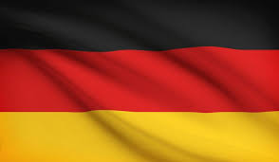
German Business Etiquette and Communication
Alex Kilinski, Andrew Whiteley and Riley Mcclain

Slide 2
Background
One of top 4 global economies
Leading exporter in Europe
Separated into East and West
Large trading partner with the U.S

Slide 3
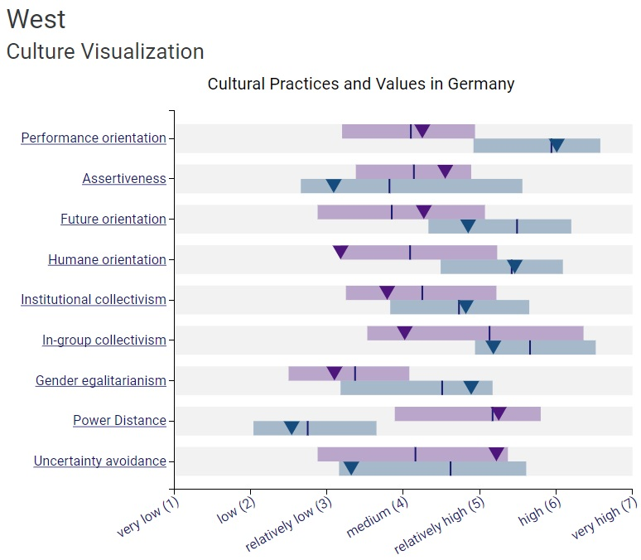
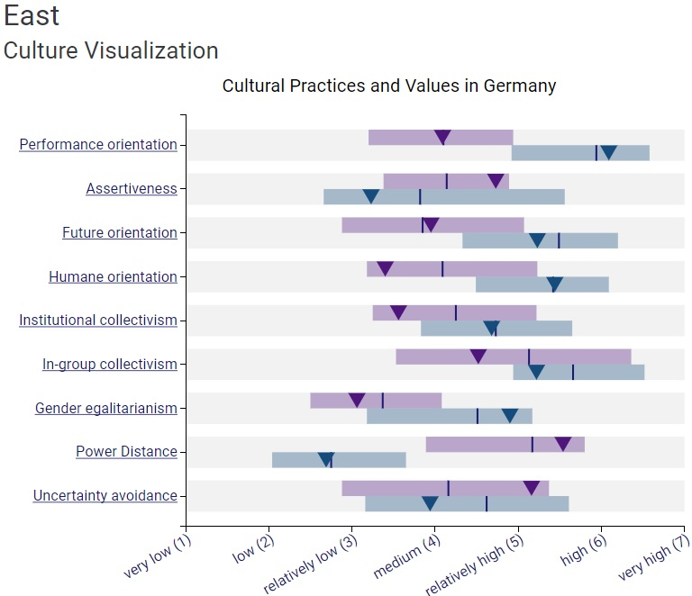
Germany’s Globe Ratings
Notes:
Topics:
The divide between East and West
Starting after the Second World War, the east was partitioned from the West. The political differences lead to a slight Culturable divide within the country. This divide is not too large, and doesnt chance to much of business culture, but it's enough to warrant a second graph in the eyes of Globe.
Both sides of Germany have a High Performance Orientation, Assertiveness and Future Orientation. Both also has a very high Power Distance and Uncertainty Avoidance.
What these scores tell us about Germany and how their Business Culture is
Germany’s high In-group Collectivism and high power distance make the business culture very formal.
The high levels of Performance Orientation, Uncertainty Avoidance, and

Slide 4
Business Etiquette
German business culture can be defined by
  Formality
    Dress, Names and Titles, Friendships, etc.
  Efficiency
    Performance Oriented, Meetings, ect.
German and English Speaker
  “Guten” means good, add “tag” (day), “morgen” (morning), or “Abend” (evening), to make an easy greeting.
  “Auf Wiedersehen” is a classic German goodbye. “Tschuss” is another, but is more causal.
  “Herr” means Mr. in German and “Frau” means Mrs./Ms.
Notes:
Topics:
Formality
Dress is very important for Germans
Titles and Positions are very important for Germans and business is conducted with people in similar position groups
Friendships are not discouraged within the workplace, but they take longer to develop due to the formality of work culture.
Efficiency
The Germans are very performance oriented and this shows in their business culture
Meetings in Germany are planed to a tee. Noone who isn't needed to be there goes, and the agendas are rigid and planed weeks in advance.
Common Phrases and words that will help will business etiquette.

Slide 5
How Business Etiquette Relates to Business Communication
Majority of German business etiquette is directly related to communication
  Addressing them formally will show respect
  Preparation necessary in all business deals no matter what
  Efficient business meetings get directly to the point
Individualistic and perfectionist mindset
  Demonstrate your passion and drive
  Following up on business deals to show progress

Slide 6
Examples of This Relationship
Planning and efficiency
  Expect meetings to be planned far in advance
  When speaking at meetings, present only relevant information
  Meetings should show preparation and be time efficient
Formal and conservative behavior
  Do not contact outside of work hours (After 5 Mon-Thurs; After 4 Fri)
  Private and professional lives are separated
  Keep this line at all times

Slide 7
Recommendations
Conduct business professionally
Arrive at business meetings early (Germans value their time)
Wear professional attire
2. Thoroughly plan out all meetings with your German partners or clients
We recommend having multiple meetings with executives and employees to properly prepare for your encounter with the German company.
They do not like their time to be wasted and they find relaxed and unplanned environments to be unprofessional.

Slide 8
Recommendations
3. Keep personal life and business separate.
Only conduct business with a German company during business hours (keep in mind of the 6 hour time difference)
Also avoid asking about their personal lives such as family and friends when conducting business.

Slide 9
References
Priest, Matt. “Germany Business Etiquette, Culture, & Manners.” Germany - German Business Etiquette, Manners, Cross Cultural Communication, and Geert Hofstede, www.cyborlink.com/besite/germany.htm
“Business Etiquette.” Business Culture, businessculture.org/western-europe/business-culture-in-germany/business-etiquette-in-germany/.
“Business Communication.” Business Culture, businessculture.org/western-europe/business-culture-in-germany/business-communication-in-germany/.
https://www.google.com/imgres?imgurl=https%3A%2F%2Fwww.worldatlas.com%2Fr%2Fw728-h425-c728x425%2Fupload%2F63%2F3f%2F7a%2Funtitled-design-281.jpg&imgrefurl=https%3A%2F%2Fwww.worldatlas.com%2Farticles%2Fwhat-do-the-colors-of-the-german-flag-mean.html&docid=S0lyxJJeX_r1KM&tbnid=vfvgZZRWEaLZaM%3A&vet=10ahUKEwjLpKrCx9ThAhXng-AKHXCvBpQQMwhpKAEwAQ..i&w=729&h=425&bih=610&biw=1280&q=germany%20flag&ved=0ahUKEwjLpKrCx9ThAhXng-AKHXCvBpQQMwhpKAEwAQ&iact=mrc&uact=8

